Slide 1
Lectures 23-26 Proof Techniques
N D Gangadhar

Slide 2
Intended Learning Outcomes
At the end of the topic lectures, the student will be able to
Describe the nature and types of Mathematical Proofs
Explain Proof Methods
Explain and apply Proof Strategies
Explain Mathematical Induction, Strong Induction
Apply Mathematical Induction and Strong Induction to construct proofs
Explain recursive definitions and recursive algorithms
Explain and apply structural induction to prove recursive formulas and algorithms

Slide 3
Topics
Mathematical Proofs
Proof Methods
Proof Strategies
Mathematical Induction
Strong Induction
Well Ordering
Recursive Definitions
Structural Induction
Recursive Algorithms

Slide 4
Section 1: Mathematical Proofs

Slide 5
Section Outline
Mathematical Proofs
Forms of Theorems
Direct Proofs
Indirect Proofs
Proof of the Contrapositive
Proof by Contradiction

Slide 6
Proofs of Mathematical Statements
A proof is a valid argument that establishes the truth of a statement.
Proofs have many practical applications:
Verification that computer programs are correct
Establishing that operating systems are secure
Enabling programs to make inferences in artificial intelligence
Showing that system specifications are consistent

Slide 7
Definitions
A theorem is a statement that can be shown to be true using:
Definitions
Other theorems
Axioms (statements which are given as true)
Rules of inference
A lemma is a ‘helping theorem’ or a result which is needed to prove a theorem.
A corollary is a result which follows directly from a theorem.
Less important theorems are sometimes called propositions.
A conjecture is a statement that is being proposed to be true.
Once a proof of a conjecture is found, it becomes a theorem.
However, a conjecture may turn out to be false.

Slide 8
Forms of Theorems
Many theorems assert that a property holds for all elements in a domain, such as the integers, the real numbers, or some of the discrete structures that we will study in this class.
Often the universal quantifier (needed for a precise statement of a theorem) is omitted by standard mathematical convention.
For example, the statement:
“If x > y, where x and y are positive real numbers, then x² > y² ”
really means
“For all positive real numbers x and y, if x > y, then x² > y² .”

Slide 9
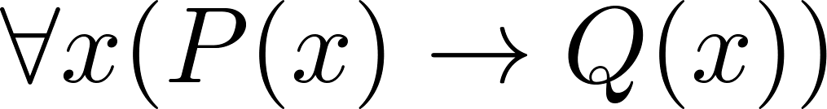
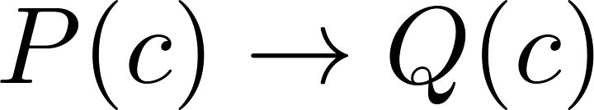

Proving Theorems
Many theorems have the form:
To prove them, we show that where c is an arbitrary element of the domain,
So, we must prove something of the form:

Slide 10
Proving Conditional Statements: p → q (0) The easy cases
Trivial Proof: If we know q is true, then p → q is true as well.
“If it is raining then 1=1.”
Vacuous Proof: If we know p is false then p → q is true as well.
“If I am both rich and poor then 2 + 2 = 5.”
Even though these examples seem silly, both trivial and vacuous proofs are often used in mathematical induction, as we will see later

Slide 11
Even and Odd Integers
Definition: The integer n is even if there exists an integer k such that n = 2k, and n is odd if there exists an integer k, such that n = 2k + 1.
Note that every integer is either even or odd and no integer is both even and odd.
We will need this basic fact about the integers in some of the example proofs to follow.

Slide 12
Proving Conditional Statements: p → q (1) Direct Proof
Direct Proof: Assume that p is true. Use rules of inference, axioms, and logical equivalences to show that q must also be true.
Example: Give a direct proof of the theorem “If n is an odd integer, then n² is odd.”

Slide 13
Proving Conditional Statements: p → q (1) Direct Proof
Direct Proof: Assume that p is true. Use rules of inference, axioms, and logical equivalences to show that q must also be true.
Example: Give a direct proof of the theorem “If n is an odd integer, then n² is odd.”
Solution: Assume that n is odd. Then n = 2k + 1 for an integer k. Squaring both sides of the equation, we get:
n² = (2k + 1)² = 4k² + 4k +1 = 2(2k² + 2k) + 1= 2r + 1,
where r = 2k² + 2k , an integer.
We have proved that if n is an odd integer, then n² is an odd integer.
( marks the end of the proof. Sometimes QED is used instead. )

Slide 14
Proving Conditional Statements: p → q (1) Direct Proof
Definition: The real number r is rational if there exist integers p and q where q≠0 such that r = p/q
Example: Prove that the sum of two rational numbers is rational.

Slide 15
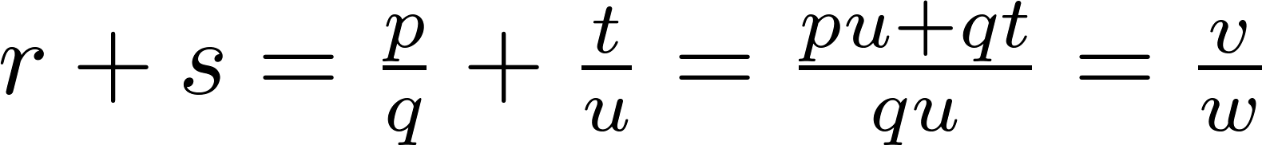
Proving Conditional Statements: p → q (1) Direct Proof
Definition: The real number r is rational if there exist integers p and q where q≠0 such that r = p/q
Example: Prove that the sum of two rational numbers is rational.
Solution: Assume r and s are two rational numbers. Then there must be integers p, q and also t, u such that
Thus the sum is rational.
where v = pu + qt
w = qu ≠ 0

Slide 16
Proving Conditional Statements: p → q (2) Proof by Contraposition
Proof by Contraposition: Assume ¬q and show ¬p is true also.
This is sometimes called an indirect proof method. If we give a direct proof of ¬q → ¬p then we have a proof of p → q.
Why does this work?
Example: Prove that if n is an integer and 3n + 2 is odd, then n is odd.

Slide 17
Proving Conditional Statements: p → q (2) Proof by Contraposition
Example: Prove that if n is an integer and 3n + 2 is odd, then n is odd.
Solution: Assume n is even. So, n = 2k for some integer k. Thus
3n + 2 = 3(2k) + 2 =6k +2 = 2(3k + 1) = 2j for j = 3k +1
Therefore 3n + 2 is even. Since we have shown ¬q → ¬p , p → q must hold as well. If n is an integer and 3n + 2 is odd (not even) , then n is odd (not even).

Slide 18
Proving Conditional Statements: p → q (2) Proof by Contraposition
Example: Prove that for an integer n, if n² is odd, then n is odd.

Slide 19
Proving Conditional Statements: p → q (2) Proof by Contraposition
Example: Prove that for an integer n, if n² is odd, then n is odd.
Solution: Use proof by contraposition. Assume n is even (i.e., not odd). Therefore, there exists an integer k such that n = 2k. Hence,
n² = 4k² = 2 (2k²)
and n² is even (i.e., not odd).
We have shown that if n is an even integer, then n² is even. Therefore by contraposition, for an integer n, if n² is odd, then n is odd.

Slide 20
Proving Conditional Statements: p → q (3) Proof by Contradiction
Proof by Contradiction: (AKA reductio ad absurdum).
To prove p, assume ¬p and derive a contradiction such as p ∧ ¬p (an indirect form of proof).
Since we have shown that ¬p →F is true, it follows that the contrapositive T→p also holds.

Slide 21
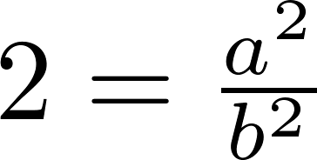
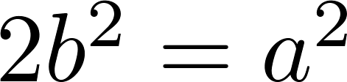
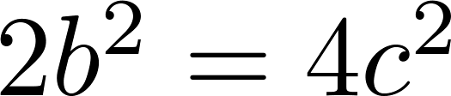
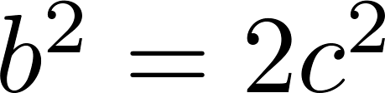
Proving Conditional Statements: p → q (3) Proof by Contradiction
Example: Use a proof by contradiction to give a proof that √2 is irrational.
Solution: Suppose √2 is rational. Then there exists integers a and b with √2 = a/b, where b≠ 0 and a and b have no common factors (see Chapter 4). Then
Therefore a² must be even. If a² is even then a must be even (an exercise). Since a is even, a = 2c for some integer c. Thus,
Therefore b² is even. Again then b must be even as well.
But then 2 must divide both a and b. This contradicts our assumption that a and b have no common factors. We have proved by contradiction that our initial assumption must be false and therefore √2 is irrational .

Slide 22
Proving Conditional Statements: p → q (3) Proof by Contradiction
Example: Prove that there is no largest prime number.

Slide 23
Proof by Contradiction
Example: Prove that there is no largest prime number.
Solution: Assume that there is a largest prime number. Call it p_{n}. Hence, we can list all the primes 2,3,.., p_{n}. Form
None of the prime numbers on the list divides r. Therefore, by a theorem on prime numbers, either r is prime or there is a smaller prime that divides r. This contradicts the assumption that there is a largest prime. Therefore, there is no largest prime.

Slide 24
Theorems that are Biconditional Statements
To prove a theorem that is a biconditional statement, that is, a statement of the form p ↔ q, we show that p → q and q →p are both true.
Example: Prove the theorem: “If n is an integer, then n is odd if and only if n² is odd.”
Solution: We have already shown (previous slides) that both p →q and q →p. Therefore we can conclude p ↔ q.
Sometimes iff is used as an abbreviation for “if an only if,” as in
“If n is an integer, then n is odd iff n² is odd.”

Slide 25
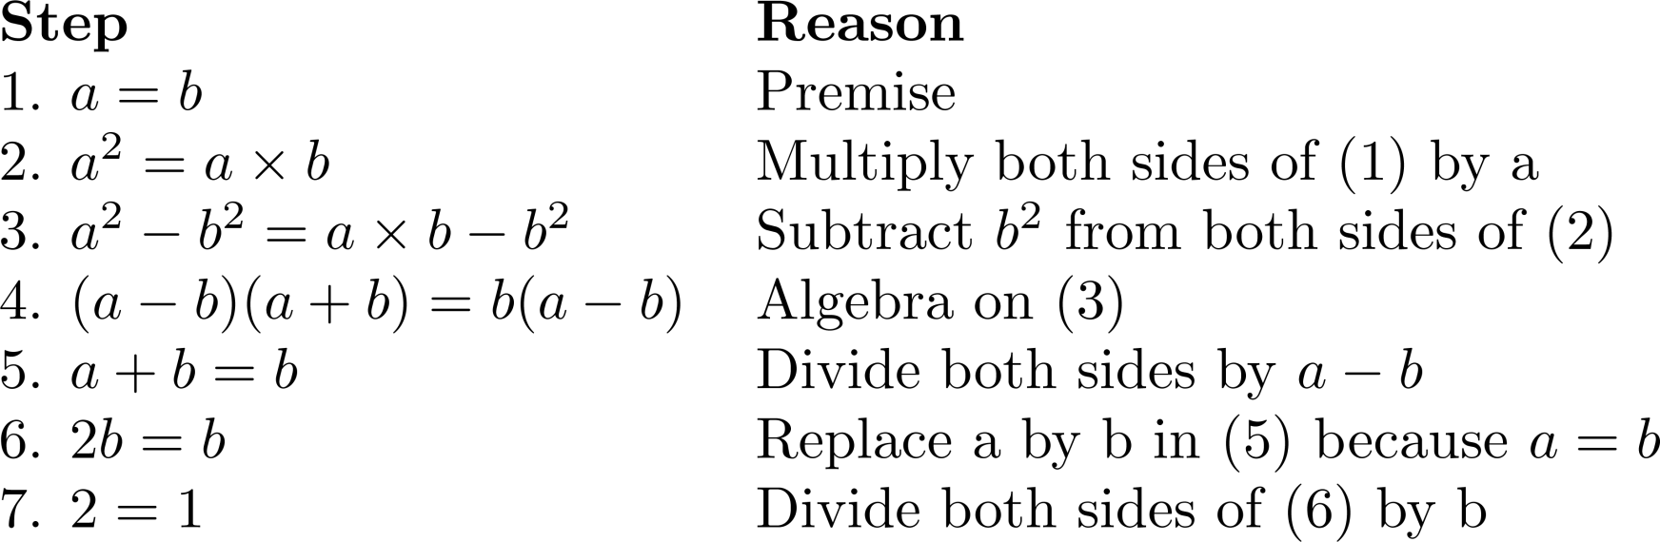
Fallacious Proof
What is wrong with the following “Proof”?
“Proof” that 1 = 2.We use these steps, where a and b are two equal positive integers.

Slide 26
Fallacious Proof
“Proof” that 1 = 2.We use these steps, where a and b are two equal positive integers.
Solution: Step 5. a - b = 0 by the premise and division by 0 is undefined.

Slide 27
Looking Ahead
If direct methods of proof do not work:
We may need a clever use of a proof by contraposition.
Or a proof by contradiction.
In the next section, we will see strategies that can be used when straightforward approaches do not work.
Later, we will discuss mathematical induction and related techniques.
Even further, we will discuss combinatorial proofs

Slide 28
Section 2: Proof Methods and Strategy

Slide 29
Section Outline
Proof by Cases
Without Loss of Generality
Existence Proofs
Constructive
Nonconstructive
Disproof by Counterexample
Uniqueness Proofs
Proof and Disproof
Open Problems

Slide 30
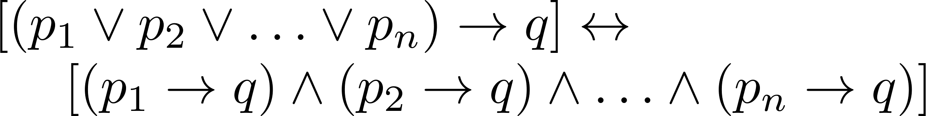

Proof by Cases
To prove a conditional statement of the form:
use the tautology
Each of the implications is a case.

Slide 31
Proof by Cases
Example: Let a @ b = max{a, b} = a if a ≥ b, and a @ b = max{a, b} = b, otherwise. Show that for all real numbers a, b, c, (a @b) @ c = a @ (b @ c) (This means the operation @ is associative.)

Slide 32
Proof by Cases
Example: Let a @ b = max{a, b} = a if a ≥ b, otherwise a @ b = max{a, b} = b. Show that for all real numbers a, b, c (a @b) @ c = a @ (b @ c) (This means the operation @ is associative.)
Proof: Let a, b, and c be arbitrary real numbers. Then one of the following 6 cases must hold.
a ≥ b ≥ c
a ≥ c ≥ b
b ≥ a ≥c
b ≥ c ≥a
c ≥ a ≥ b
c ≥ b ≥ a
Continued on next slide →

Slide 33
Proof by Cases
Case 1: a ≥ b ≥ c
(a @ b) = a, a @ c = a, b @ c = b
Hence (a @ b) @ c = a = a @ (b @ c)
Therefore the equality holds for the first case.
A complete proof requires that the equality be shown to hold for all 6 cases. But the proofs of the remaining cases are similar. Try them.

Slide 34
Without Loss of Generality
Example: Show that if x and y are integers and both x∙y and x+y are even, then both x and y are even.

Slide 35
Without Loss of Generality
Example: Show that if x and y are integers and both x∙y and x+y are even, then both x and y are even.
Proof: Use a proof by contraposition. Suppose x and y are not both even. Then, one or both are odd. Without loss of generality, assume that x is odd. Then x = 2m + 1 for some integer k.
Case 1: y is even. Then y = 2n for some integer n, so x + y = (2m + 1) + 2n = 2(m + n) + 1 is odd.
Case 2: y is odd. Then y = 2n + 1 for some integer n, so x ∙ y = (2m + 1) (2n + 1) = 2(2m ∙ n +m + n) + 1 is odd.
We only cover the case where x is odd because the case where y is odd is similar. The use phrase without loss of generality (WLOG) indicates this.

Slide 36
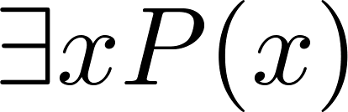
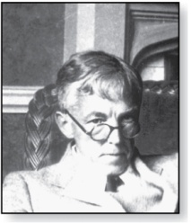
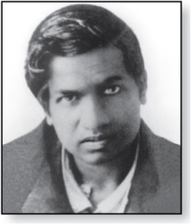
Existence Proofs
Proof of theorems of the form
Constructive existence proof:
Find an explicit value of c, for which P(c) is true.
Example: Show that there is a positive integer that can be written as the sum of cubes of positive integers in two different ways:
Proof: 1729 is such a number since
1729 = 10³ + 9³ = 12³ + 1³
Godfrey Harold Hardy
(1877-1947)
Srinivasa Ramanujan
(1887-1920)

Slide 37
Nonconstructive Existence Proofs
Example: Show that there exist irrational numbers x and y such that x^{y} is rational.

Slide 38
Nonconstructive Existence Proofs
Example: Show that there exist irrational numbers x and y such that x^{y} is rational.
Proof: We know that √2 is irrational. Consider the number √2 ^{√2} .
If it is rational, we have two irrational numbers x and y with x^{y} rational, namely x = √2 and y = √2.
But, if √2 ^{√2} is irrational, then we can let x = √2 ^{√2} and y = √2 so that x^{y} = (√2 ^{√2} )^{√2} =
√2 ^{(√2 √2)} = √2 ² = 2.

Slide 39
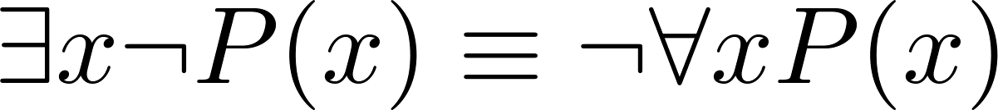
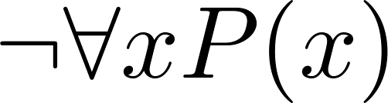
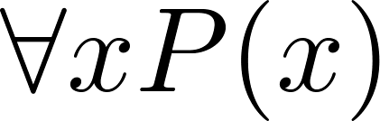
Counterexamples
Recall .
To establish that is true (or is false) find a c such that ¬P(c) is true or P(c) is false.
In this case c is called a counterexample to the assertion
Example: “Every positive integer is the sum of the squares of 3 integers.” The integer 7 is a counterexample. So the claim is false.

Slide 40
Uniqueness Proofs
Some theorems asset the existence of a unique element with a particular property, ∃!x P(x). The two parts of a uniqueness proof are
Existence: We show that an element x with the property exists.
Uniqueness: We show that if y≠x, then y does not have the property.
Example: Show that if a and b are real numbers and a ≠0, then there is a unique real number r such that ar + b = 0.

Slide 41
Uniqueness Proofs
The two parts of a uniqueness proof are
Existence: We show that an element x with the property exists.
Uniqueness: We show that if y≠x, then y does not have the property.
Example: Show that if a and b are real numbers and a ≠0, then there is a unique real number r such that ar + b = 0.
Solution:
Existence: The real number r = −b/a is a solution of ar + b = 0 because a(−b/a) + b = −b + b =0.
Uniqueness: Suppose that s is a real number such that as + b = 0. Then ar + b = as + b, where r = −b/a. Subtracting b from both sides and dividing by a shows that r = s.

Slide 42
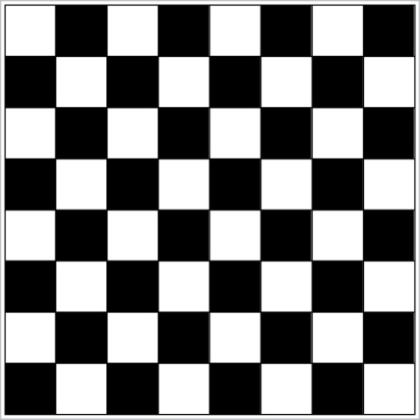
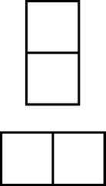
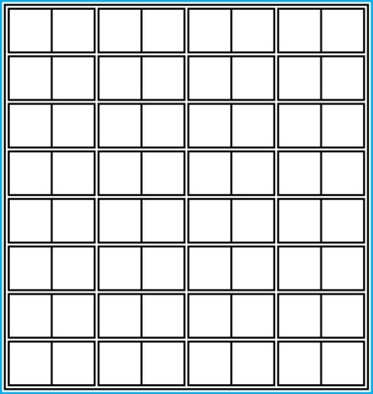
Proof and Disproof: Tilings
Example 1: Can we tile the standard checkerboard using dominos?
Solution: Yes! One example provides a constructive existence proof.
Two Dominoes
The Standard Checkerboard
One Possible Solution

Slide 43
Tilings
Example 2: Can we tile a checkerboard obtained by removing one of the four corner squares of a standard checkerboard?

Slide 44
Tilings
Example 2: Can we tile a checkerboard obtained by removing one of the four corner squares of a standard checkerboard?
Solution: No. Assume otherwise.
Our checkerboard has 64 − 1 = 63 squares.
Since each domino has two squares, a board with a tiling must have an even number of squares.
The number 63 is not even.
We have a contradiction.

Slide 45
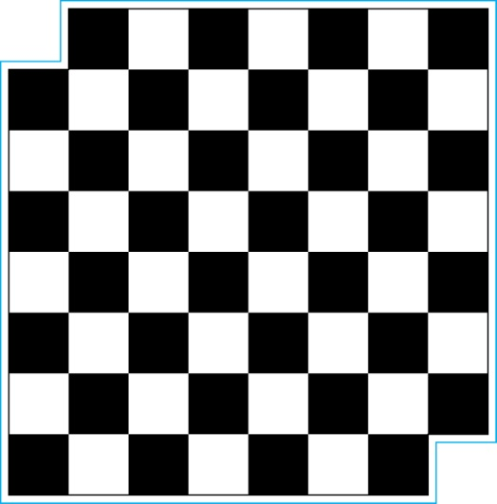
Tilings
Example 3: Can we tile a board obtained by removing both the upper left and the lower right squares of a standard checkerboard?
Dominoes
Nonstandard Checkerboard
Continued on next slide →

Slide 46
Tilings
Solution: No.
There are 62 squares in this board.
To tile it we need 31 dominos.
Key fact: Each domino covers one black and one white square.
Therefore the tiling covers 31 black squares and 31 white squares.
Our board has either 30 black squares and 32 white squares or 32 black squares and 30 white squares.
Contradiction!

Slide 47
The Role of Open Problems
Unsolved problems have motivated much work in mathematics.
Fermat’s Last Theorem was conjectured more than 300 years ago. It has only recently been finally solved.
Fermat’s Last Theorem: The equation x^{n} + y^{n} = z^{n} has no solutions in integers x, y, and z, with xyz≠0 whenever n is an integer with n > 2. A proof was found by Andrew Wiles in the 1990s.

Slide 48
An Open Problem
The 3x + 1 Conjecture: Let T be the transformation that sends an even integer x to x/2 and an odd integer x to 3x + 1.
For all positive integers x, when we repeatedly apply the transformation T, we will eventually reach the integer 1.
For example, starting with x = 13:
T(13) = 3∙13 + 1 = 40, T(40) = 40/2 = 20, T(20) = 20/2 = 10,
T(10) = 10/2 = 5, T(5) = 3∙5 + 1 = 16,T(16) = 16/2 = 8,
T(8) = 8/2 = 4, T(4) = 4/2 = 2, T(2) = 2/2 = 1
The conjecture has been verified using computers up to 5.6 ∙ 10¹³ but that does not prove it!

Slide 49
Additional Proof Methods
We will see other proof methods:
Mathematical Induction, which is a useful method for proving statements of the form ∀n P(n), where the domain consists of all positive integers.
Structural Induction, which can be used to prove such results about recursively defined sets.
Combinatorial Proofs, which use counting arguments.

Slide 50
Section 3: Mathematical Induction

Slide 51
Section Outline
Mathematical Induction
Examples of Proof by Mathematical Induction
Mistaken Proofs by Mathematical Induction
Guidelines for Proofs by Mathematical Induction

Slide 52
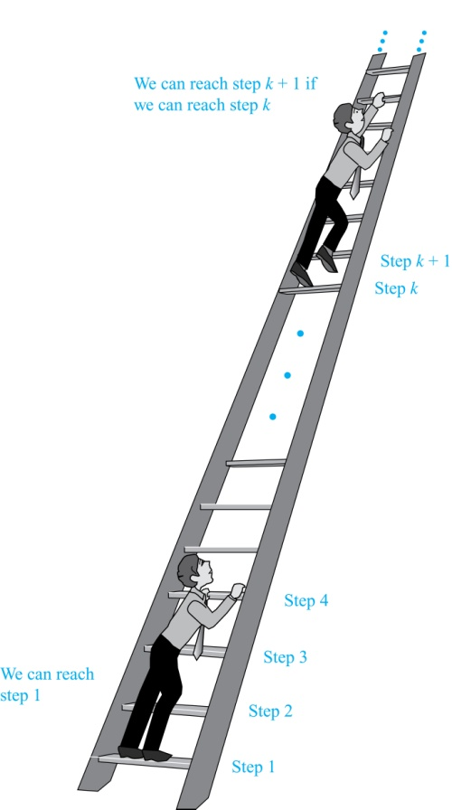
Climbing an Infinite Ladder
Suppose we have an infinite ladder:
We can reach the first rung of the ladder.
If we can reach a particular rung of the ladder, then we can reach the next rung.
From (1), we can reach the first rung. Then by applying (2), we can reach the second rung. Applying (2) again, the third rung. And so on. We can apply (2) any number of times to reach any particular rung, no matter how high up.
This example motivates proof by mathematical induction.

Slide 53
Principle of Mathematical Induction
Principle of Mathematical Induction:
To prove that P(n) is true for all positive integers n, we complete these steps:
Basis Step: Show that P(1) is true.
Inductive Step: Show that P(k) → P(k + 1) is true for all positive integers k.
To complete the inductive step, assume the inductive hypothesis that P(k) holds for an arbitrary integer k, and show that must P(k + 1) be true.
Infinite Ladder Example: Prove that we can reach every rung.
BASIS STEP: By (1), we can reach rung 1.
INDUCTIVE STEP: Assume the inductive hypothesis that we can reach rung k. Then by (2), we can reach rung k + 1.
Hence, P(k) → P(k + 1) is true for all positive integers k. We can reach every rung on the ladder.

Slide 54
Using Mathematical Induction
Mathematical induction can be expressed as the rule of inference
where the domain is the set of positive integers.
In a proof by mathematical induction, we don’t assume that P(k) is true for all positive integers! We show that if we assume that P(k) is true, then P(k + 1) must also be true.
Proofs by mathematical induction do not always start at the integer 1. In such a case, the basis step begins at a starting point b where b is an integer. We will see examples of this soon.
(P(1) ∧ ∀k(P(k) → P(k + 1))) → ∀n P(n)

Slide 55
Validity of Mathematical Induction
Mathematical induction is valid because of the well ordering property, which states that “Every nonempty subset of the set of positive integers has a least element .“
Here is the proof (by contradiction) that mathematical induction is valid:
Suppose P(1) holds and P(k) → P(k + 1) is true for all positive integers k.
Assume there is at least one positive integer n for which P(n) is false. Then the set S of positive integers n for which P(n) is false is nonempty.
By the well-ordering property, S has a least element, say m, and P(m) = F.
We know that m cannot be 1 since P(1) is true.
Since m is positive and greater than 1, m − 1 must be a positive integer. Since m − 1 < m, it is not in S, so P(m − 1) must be true.
But then, since the conditional P(k) → P(k + 1) for every positive integer k holds, P(m) must also be true. This contradicts P(m) being false.
Hence, P(n) must be true for every positive integer n.

Slide 56
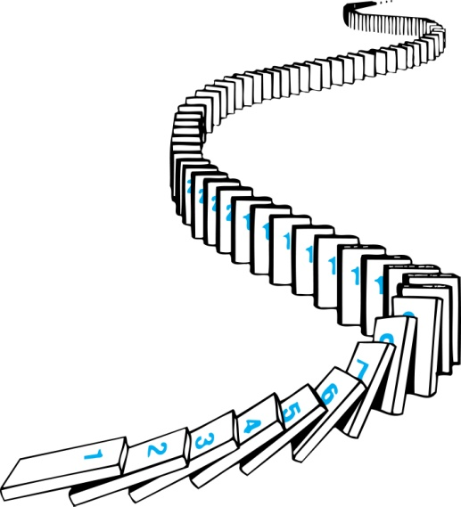
How Mathematical Induction Works
Consider an infinite sequence of dominoes, labeled 1,2,3, …, where each domino is standing.
Let P(n) be the proposition that the nth domino is knocked over.
We know that the first domino is knocked down, i.e., P(1) is true
We also know that whenever the kth domino is knocked over, it knocks over the (k + 1)st domino, i.e, P(k) → P(k + 1) is true for all positive integers k.
Hence, all dominos are knocked over.
P(n) is true for all positive integers n.

Slide 57
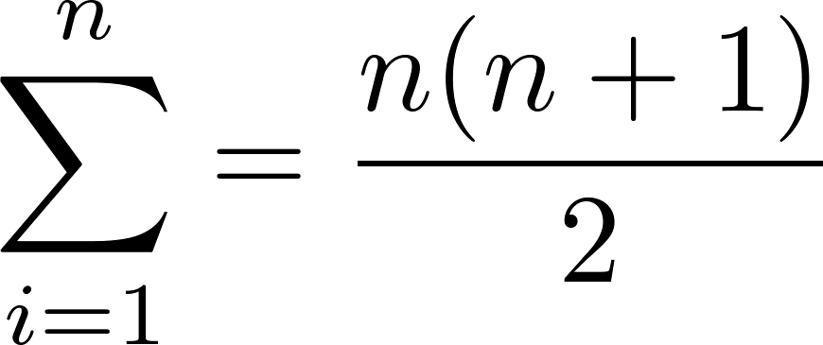
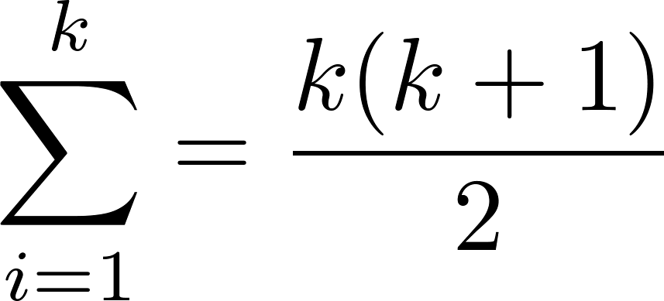
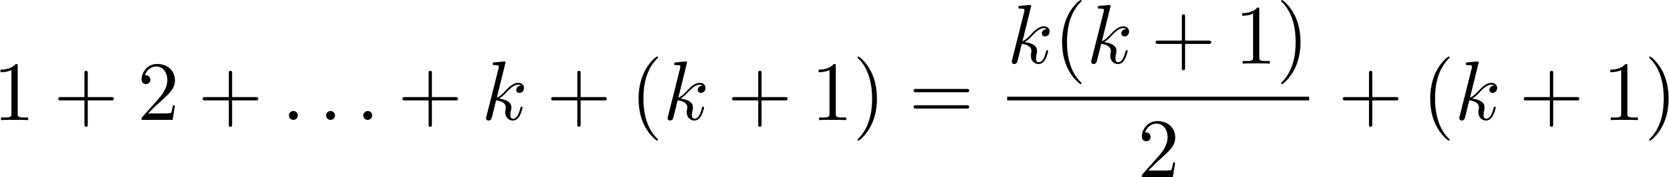
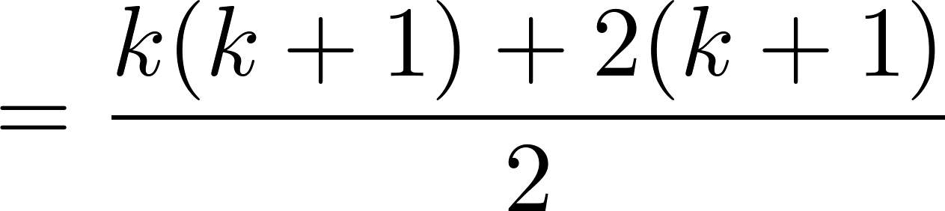
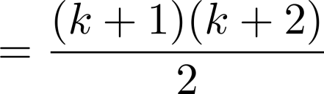
Proving a Summation Formula by Mathematical Induction
Example: Show that:
Solution:
BASIS STEP: P(1) is true since 1(1 + 1)/2 = 1.
INDUCTIVE STEP: Assume true for P(k).
The inductive hypothesis is
Under this assumption,
Note: Once we have this conjecture, mathematical induction can be used to prove it correct.

Slide 58
Conjecturing and Proving Correct a Summation Formula
Example: Conjecture and prove correct a formula for the sum of the first n positive odd integers. Then prove your conjecture.
Solution: We have: 1= 1, 1 + 3 = 4, 1 + 3 + 5 = 9, 1 + 3 + 5 + 7 = 16, 1 + 3 + 5 + 7 + 9 = 25.
We can conjecture that the sum of the first n positive odd integers is n²,
We prove the conjecture is proved correct with mathematical induction.
1 + 3 + 5 + ∙∙∙+ (2n − 1) = n² .

Slide 59
Conjecturing and Proving Correct a Summation Formula
Example: Conjecture and prove correct a formula for the sum of the first n positive odd integers. Then prove your conjecture.
Solution: We have: 1= 1, 1 + 3 = 4, 1 + 3 + 5 = 9, 1 + 3 + 5 + 7 = 16, 1 + 3 + 5 + 7 + 9 = 25.
We can conjecture that the sum of the first n positive odd integers is n²,
We prove the conjecture is proved correct with mathematical induction.
BASIS STEP: P(1) is true since 1² = 1.
INDUCTIVE STEP: P(k) → P(k + 1) for every positive integer k.
Assume the inductive hypothesis holds and then show that P(k) holds has well.
So, assuming P(k), it follows that:
Hence, we have shown that P(k + 1) follows from P(k). Therefore, by the principle of mathematical induction, the sum of the first n positive odd integers is n².
1 + 3 + 5 + ∙∙∙+ (2n − 1) = n² .
Inductive Hypothesis: 1 + 3 + 5 + ∙∙∙+ (2k − 1) =k²
1 + 3 + 5 + ∙∙∙+ (2k − 1) + (2k + 1) =[1 + 3 + 5 + ∙∙∙+ (2k − 1)] + (2k + 1)
= k² + (2k + 1) (by the inductive hypothesis)
= k² + 2k + 1
= (k + 1) ²

Slide 60
Proving Inequalities
Example: Use mathematical induction to prove that n < 2^{n} for all positive integers n.
Solution: Let P(n) be the proposition that n < 2^{n}.
BASIS STEP: P(1) is true since 1 < 2¹ = 2.
INDUCTIVE STEP: Assume P(k) holds, i.e., k < 2^{k}, for an arbitrary positive integer k.
Must show that P(k + 1) holds. Since by the inductive hypothesis, k < 2^{k}, it follows that:
k + 1 < 2^{k} + 1 ≤ 2^{k} + 2^{k} = 2 ∙ 2^{k} = 2^{k+1}
Therefore n < 2^{n} holds for all positive integers n

Slide 61
Proving Inequalities
Example: Use mathematical induction to prove that 2^{n} < n!, for every integer n ≥ 4.

Slide 62
Proving Inequalities
Example: Use mathematical induction to prove that 2^{n} < n!, for every integer n ≥ 4.
Solution: Let P(n) be the proposition that 2^{n} < n!.
BASIS STEP: P(4) is true since 2⁴ = 16 < 4! = 24.
INDUCTIVE STEP: Assume P(k) holds, i.e., 2^{k} < k! for an arbitrary integer k ≥ 4. To show that P(k + 1) holds:
2^{k+1} = 2∙2^{k}
< 2∙ k! (by the inductive hypothesis)
< (k + 1)k!
= (k + 1)!
Therefore, 2^{n} < n! holds, for every integer n ≥ 4.
Note that here the basis step is P(4), since P(0), P(1), P(2), and P(3) are all false.

Slide 63
Proving Divisibility Results
Example: Use mathematical induction to prove that n³ − n is divisible by 3, for every positive integer n.

Slide 64
Proving Divisibility Results
Example: Use mathematical induction to prove that n³ − n is divisible by 3, for every positive integer n.
Solution: Let P(n) be the proposition that n³ − n is divisible by 3.
BASIS STEP: P(1) is true since 1³ − 1 = 0, which is divisible by 3.
INDUCTIVE STEP: Assume P(k) holds, i.e., k³ − k is divisible by 3, for an arbitrary positive integer k. To show that P(k + 1) follows:
(k + 1)³ − (k + 1) = (k³ + 3k² + 3k + 1) − (k + 1)
= (k³ − k) + 3(k² + k)
By the inductive hypothesis, the first term (k³ − k) is divisible by 3 and the second term is divisible by 3 since it is an integer multiplied by 3. So by part (i) of Theorem 1 in Section 4.1 , (k + 1)³ − (k + 1) is divisible by 3.
Therefore, n³ − n is divisible by 3, for every integer positive integer n.

Slide 65
Number of Subsets of a Finite Set
Example: Use mathematical induction to show that if S is a finite set with n elements, where n is a nonnegative integer, then S has 2^{n} subsets.
Solution: Let P(n) be the proposition that a set with n elements has 2^{n} subsets.
Basis Step: P(0) is true, because the empty set has only itself as a subset and 2⁰ = 1.
Inductive Step: Assume P(k) is true for an arbitrary nonnegative integer k.
continued →

Slide 66
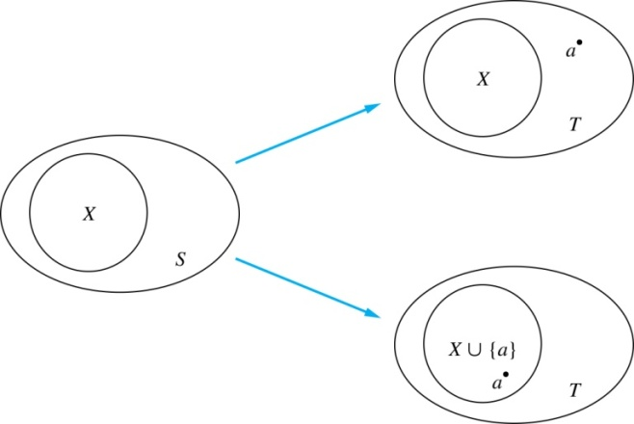
Number of Subsets of a Finite Set
Inductive Hypothesis: For an arbitrary nonnegative integer k, every set with k elements has 2^{k} subsets.
Let T be a set with k + 1 elements. Then T = S ∪ {a}, where a ∈ T and S = T − {a}. Hence |T| = k.
For each subset X of S, there are exactly two subsets of T, i.e., X and X ∪ {a}.
By the inductive hypothesis S has 2^{k} subsets. Since there are two subsets of T for each subset of S, the number of subsets of T is 2 ∙2^{k} = 2^{k+1} .

Slide 67

Tiling Checkerboards
Example: Show that every 2^{n} ×2^{n} checkerboard with one square removed can be tiled using right triominoes.
A right triomino is an L-shaped tile which covers three squares at a time.
continued →

Slide 68

Tiling Checkerboards
Example: Show that every 2^{n} ×2^{n} checkerboard with one square removed can be tiled using right triominoes.
Solution: Let P(n) be the proposition that every 2^{n} ×2^{n} checkerboard with one square removed can be tiled using right triominoes. Use mathematical induction to prove that P(n) is true for all positive integers n.
BASIS STEP: P(1) is true, because each of the four 2 ×2 checkerboards with one square removed can be tiled using one right triomino.
INDUCTIVE STEP: Assume that P(k) is true for every 2^{k} ×2^{k} checkerboard, for some positive integer k.
continued →

Slide 69
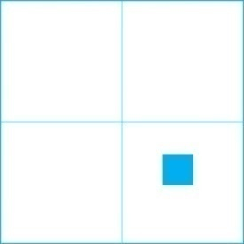

Tiling Checkerboards
Inductive Hypothesis: Every 2^{k} ×2^{k} checkerboard, for some positive integer k, with one square removed can be tiled using right triominoes.
Consider a 2^{k+1} ×2^{k+1} checkerboard with one square removed. Split this checkerboard into four checkerboards of size 2^{k} ×2^{k},by dividing it in half in both directions.
Remove a square from one of the four 2^{k} ×2^{k} checkerboards. By the inductive hypothesis, this board can be tiled. Also by the inductive hypothesis, the other three boards can be tiled with the square from the corner of the center of the original board removed. We can then cover the three adjacent squares with a triominoe.
Hence, the entire 2^{k+1} ×2^{k+1} checkerboard with one square removed can be tiled using right triominoes.

Slide 70
An Incorrect “Proof” by Mathematical Induction
Example: Let P(n) be the statement that every set of n lines in the plane, no two of which are parallel, meet in a common point. Here is a “proof” that P(n) is true for all positive integers n ≥ 2.
BASIS STEP: The statement P(2) is true because any two lines in the plane that are not parallel meet in a common point.
INDUCTIVE STEP: The inductive hypothesis is the statement that P(k) is true for the positive integer k ≥ 2, i.e., every set of k lines in the plane, no two of which are parallel, meet in a common point.
We must show that if P(k) holds, then P(k + 1) holds, i.e., if every set of k lines in the plane, no two of which are parallel, k ≥ 2, meet in a common point, then every set of k + 1 lines in the plane, no two of which are parallel, meet in a common point.
continued →

Slide 71
An Incorrect “Proof” by Mathematical Induction
Inductive Hypothesis: Every set of k lines in the plane, where k ≥ 2, no two of which are parallel, meet in a common point.
Consider a set of k + 1 distinct lines in the plane, no two parallel. By the inductive hypothesis, the first k of these lines must meet in a common point p₁. By the inductive hypothesis, the last k of these lines meet in a common point p₂.
If p₁ and p₂ are different points, all lines containing both of them must be the same line since two points determine a line. This contradicts the assumption that the lines are distinct. Hence, p₁ = p₂ lies on all k + 1 distinct lines, and therefore P(k + 1) holds. Assuming that k ≥2, distinct lines meet in a common point, then every k + 1 lines meet in a common point.
There must be an error in this proof since the conclusion is absurd. But where is the error?
Answer: P(k)→ P(k + 1) only holds for k ≥3. It is not the case that P(2) implies P(3). The first two lines must meet in a common point p₁ and the second two must meet in a common point p₂. They do not have to be the same point since only the second line is common to both sets of lines.

Slide 72
Template for Proofs by Mathematical Induction
Express the statement that is to be proved in the form “for all n ≥ b, P (n)” for a fixed integer b.
Write out the words “Basis Step.” Then show that P (b) is true, taking care that the correct value of b is used. This completes the first part of the proof.
Write out the words “Inductive Step.”
State, and clearly identify, the inductive hypothesis, in the form “assume that P (k) is true for an arbitrary fixed integer k ≥ b.”
State what needs to be proved under the assumption that the inductive hypothesis is true. That is, write out what P (k + 1) says.
Prove the statement P (k + 1) making use the assumption P (k). Be sure that your proof is valid for all integers k with k ≥ b, taking care that the proof works for small values of k, including k = b.
Clearly identify the conclusion of the inductive step, such as by saying “this completes the inductive step.”
After completing the basis step and the inductive step, state the conclusion, namely that by mathematical induction, P (n) is true for all integers n with n ≥ b.

Slide 73
Section 4: Strong Induction and Well-Ordering

Slide 74
Section Outline
Strong Induction
Example of Proofs using Strong Induction
Well-Ordering Property

Slide 75
Strong Induction
Strong Induction: To prove that P(n) is true for all positive integers n, where P(n) is a propositional function, complete two steps:
Basis Step: Verify that the proposition P(1) is true.
Inductive Step: Show the conditional statement [P(1) ∧ P(2) ∧∙∙∙ ∧ P(k)] → P(k + 1) holds for all positive integers k.
Strong Induction is sometimes called the second principle of mathematical induction or complete induction.

Slide 76
Strong Induction and the Infinite Ladder
Strong induction tells us that we can reach all rungs if:
We can reach the first rung of the ladder.
For every integer k, if we can reach the first k rungs, then we can reach the (k + 1)st rung.
To conclude that we can reach every rung by strong induction:
BASIS STEP: P(1) holds
INDUCTIVE STEP: Assume P(1) ∧ P(2) ∧∙∙∙ ∧ P(k) holds for an arbitrary integer k, and show that P(k + 1) must also hold.
We will have then shown by strong induction that for every positive integer n, P(n) holds, i.e., we can reach the nth rung of the ladder.

Slide 77
Proof using Strong Induction
Example: Suppose we can reach the first and second rungs of an infinite ladder, and we know that if we can reach a rung, then we can reach two rungs higher (i.e. rung j -> rung j+2). Prove that we can reach every rung. (Try this with mathematical induction.)
Solution: Prove the result using strong induction.
BASIS STEP: We can reach the first step.
INDUCTIVE STEP: The inductive hypothesis is that we can reach the first k rungs, for any k ≥ 2. We can reach the (k + 1)st rung since we can reach the (k − 1)st rung by the inductive hypothesis.
Hence, we can reach all rungs of the ladder.

Slide 78
Choosing the Induction Form
We can always use strong induction instead of mathematical induction. But there is no reason to use it if it is simpler to use mathematical induction.
In fact, the principles of mathematical induction, strong induction, and the well-ordering property are all equivalent.
Sometimes it is clear how to proceed using one of the three methods, but not the other two.

Slide 79
Proof of the Fundamental Theorem of Arithmetic (Existence)
Example: Show that if n is an integer greater than 1, then n can be written as the product of primes.
Solution: Let P(n) be the proposition that n can be written as a product of primes.
BASIS STEP: P(2) is true since 2 itself is prime.
INDUCTIVE STEP: The inductive hypothesis is P(j) is true for all integers j with 2 ≤ j ≤ k. To show that P(k + 1) must be true under this assumption, two cases need to be considered:
If k + 1 is prime, then P(k + 1) is true.
Otherwise, k + 1 is composite and can be written as the product of two positive integers a and b with 2 ≤ a ≤ b < k + 1. By the inductive hypothesis a and b can be written as the product of primes and therefore k + 1 can also be written as the product of those primes.
Hence, it has been shown that every integer greater than 1 can be written as the product of primes.

Slide 80
Proof using Strong Induction
Example: Prove that every amount of postage of 12 cents or more can be formed using just 4-cent and 5-cent stamps.
Solution: Let P(n) be the proposition that postage of n cents can be formed using 4-cent and 5-cent stamps.
BASIS STEP: P(12), P(13), P(14), and P(15) hold.
P(12) uses three 4-cent stamps.
P(13) uses two 4-cent stamps and one 5-cent stamp.
P(14) uses one 4-cent stamp and two 5-cent stamps.
P(15) uses three 5-cent stamps.
INDUCTIVE STEP: The inductive hypothesis states that P(j) holds for 12 ≤ j ≤ k, where k ≥ 15. Assuming the inductive hypothesis, it can be shown that P(k + 1) holds.
Using the inductive hypothesis, P(k − 3) holds since k − 3 ≥ 12. To form postage of k + 1 cents, add a 4-cent stamp to the postage for k − 3 cents.
Hence, P(n) holds for all n ≥ 12.

Slide 81
Proof of Same Example using Mathematical Induction
Example: Prove that every amount of postage of 12 cents or more can be formed using just 4-cent and 5-cent stamps.
Solution: Let P(n) be the proposition that postage of n cents can be formed using 4-cent and 5-cent stamps.
BASIS STEP: Postage of 12 cents can be formed using three 4-cent stamps.
INDUCTIVE STEP: The inductive hypothesis P(k) for any positive integer k is that postage of k cents can be formed using 4-cent and 5-cent stamps. To show P(k + 1) where k ≥ 12 , we consider two cases:
If at least one 4-cent stamp has been used, then a 4-cent stamp can be replaced with a 5-cent stamp to yield a total of k + 1 cents.
Otherwise, no 4-cent stamp have been used and at least three 5-cent stamps were used. Three 5-cent stamps can be replaced by four 4-cent stamps to yield a total of k + 1 cents.
Hence, P(n) holds for all n ≥ 12.

Slide 82
Well-Ordering Property
Well-ordering property: Every nonempty set of nonnegative integers has a least element.
The well-ordering property is one of the axioms of the positive integers.
The well-ordering property can be generalized:
Definition: A set is well ordered if every subset has a least element.
N is well ordered under ≤.
The set of finite strings over an alphabet using lexicographic ordering is well ordered.

Slide 83
Well-Ordering Property
Example: Use the well-ordering property to prove the Division Algorithm, which states that if a is an integer and d is a positive integer, then there are unique integers q and r with 0 ≤ r < d, such that a = dq + r.
Solution: Let S be the set of nonnegative integers of the form a − dq, where q is an integer. The set is nonempty since −dq can be made as large as needed.
By the well-ordering property, S has a least element r = a − dq₀. The integer r is nonnegative. It also must be the case that r < d. If it were not, then there would be a smaller nonnegative element in S, namely, a − d(q₀ + 1) = a − dq₀ − d = r − d > 0.
Therefore, there are integers q and r with 0 ≤ r < d.
(Uniqueness of q and r is an Exercise)
⁻² .

Slide 84
Section 5: Recursive Definitions and Structural Induction

Slide 85
Section Outline
Recursively Defined Functions
Recursively Defined Sets and Structures
Structural Induction

Slide 86
Recursion
Recursion: “The determination of a succession of elements (as numbers or functions) by operation on one or more preceding elements according to a rule or formula involving a finite number of steps”
[Merriam-Webster Dictionary]

Slide 87
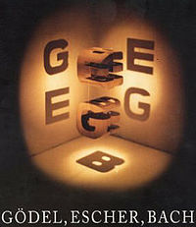
“Godel, Escher, Bach” by D. Hofstadter

Slide 88
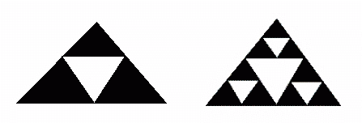
Sierpinski Triangle
Sierpinski triangles are formed by starting with a triangle and then forming 3 triangles (black) within the original by connecting the midpoints of the sides of the original triangle.
1 recursion 2 recursions

Slide 89
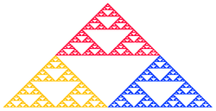
Sierpinski Triangle

Slide 90
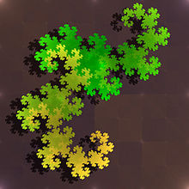
Dragon Curve

Slide 91
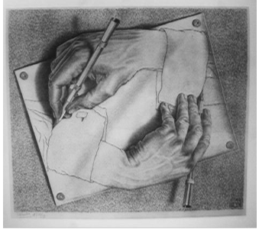
Visual Art: Escher
M.C. Escher (1898 – 1972) was a Dutch graphic artist who combined recursion and pattern repetition in a unique way.
“Drawing Hands”

Slide 92
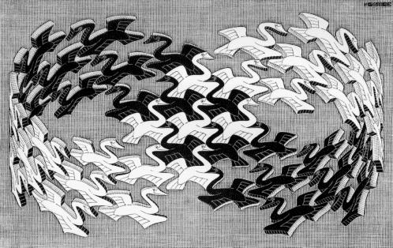
Escher: “Swans”

Slide 93
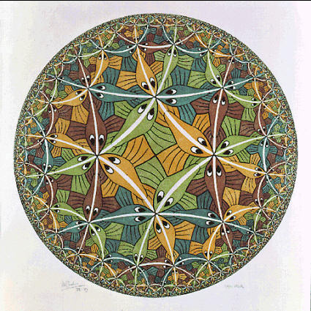
Escher: “Circle Limit III”

Slide 94
Recursively Defined Functions
Definition: A recursive or inductive definition of a function consists of two steps.
BASIS STEP: Specify the value of the function at zero.
RECURSIVE STEP: Give a rule for finding its value at an integer from its values at smaller integers.
A function f(n) is the same as a sequence a₀, a₁, … , where a_{i}, where f(i) = a_{i}. This was done using recurrence relations in Section 2.4.

Slide 95
Recursively Defined Functions
Example: Suppose f is defined by:
f(0) = 3,
f(n + 1) = 2f(n) + 3
Find f(1), f(2), f(3), f(4)
Solution:
f(1) = 2f(0) + 3 = 2∙3 + 3 = 9
f(2) = 2f(1)+ 3 = 2∙9 + 3 = 21
f(3) = 2f(2) + 3 = 2∙21 + 3 = 45
f(4) = 2f(3) + 3 = 2∙45 + 3 = 93
Example: Give a recursive definition of the factorial function n!:
Solution:
f(0) = 1
f(n + 1) = (n + 1)∙ f(n)

Slide 96
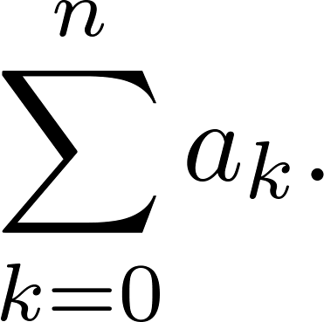
Recursively Defined Functions
Example: Give a recursive definition of:

Slide 97
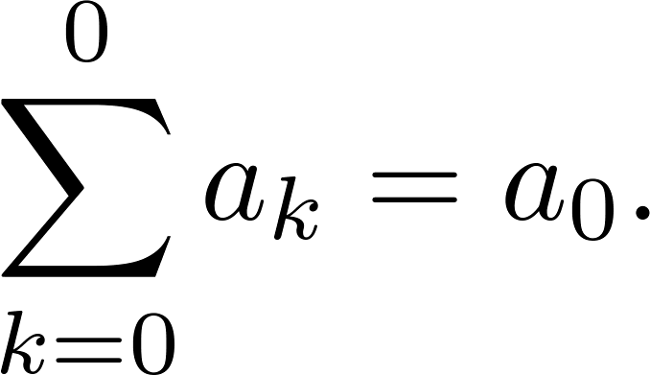
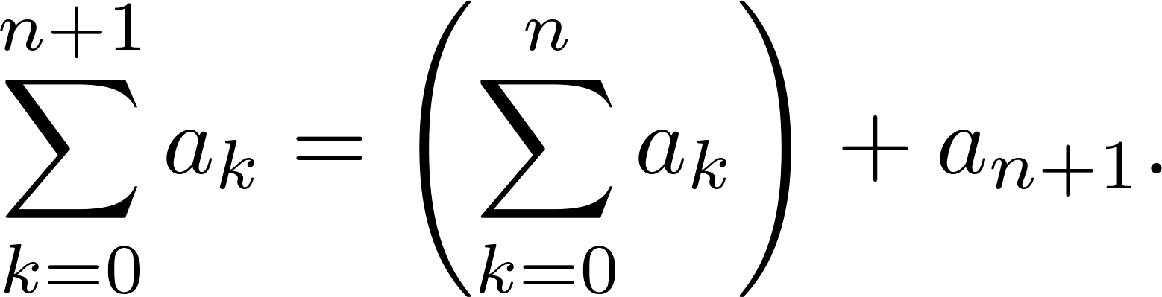
Recursively Defined Functions
Example: Give a recursive definition of:
Solution: The first part of the definition is
The second part is

Slide 98
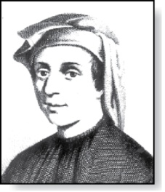
Fibonacci Numbers
Example : The Fibonacci numbers are defined as follows:
f₀ = 0
f₁ = 1
f_{n} = f_{n−1} + f_{n−2}
Find f₂, f₃ , f₄ , f₅ .
f₂ = f₁ + f₀ = 1 + 0 = 1
f₃ = f₂ + f₁ = 1 + 1 = 2
f₄ = f₃ + f₂ = 2 + 1 = 3
f₅ = f₄ + f₃ = 3 + 2 = 5
Fibonacci
(1170- 1250)

Slide 99
Recursively Defined Sets and Structures
Recursive definitions of sets have two parts:
The basis step specifies an initial collection of elements.
The recursive step gives the rules for forming new elements in the set from those already known to be in the set.
Sometimes the recursive definition has an exclusion rule, which specifies that the set contains nothing other than those elements specified in the basis step and generated by applications of the rules in the recursive step.
We will always assume that the exclusion rule holds, even if it is not explicitly mentioned.
A form of induction, called structural induction, is used to prove results about recursively defined sets.

Slide 100
Recursively Defined Sets and Structures
Example: Subset of Integers S:
BASIS STEP: 3 ∊ S.
RECURSIVE STEP: If x ∊ S and y ∊ S, then x + y is in S.
Initially 3 is in S, then 3 + 3 = 6, then 3 + 6 = 9, etc.
Example: The natural numbers N.
BASIS STEP: 0 ∊ N.
RECURSIVE STEP: If n is in N, then n + 1 is in N.
Initially 0 is in S, then 0 + 1 = 1, then 1 + 1 = 2, etc.

Slide 101
Strings
Definition: The set Σ* of strings over the alphabet Σ:
BASIS STEP: λ ∊ Σ* (λ is the empty string)
RECURSIVE STEP: If w is in Σ* and x is in Σ, then wx ∈ Σ*.
Example: If Σ = {0,1}, the strings in Σ* are the set of all bit strings, λ,0,1, 00,01,10, 11, etc.
Example: If Σ = {a,b}, show that aab is in Σ*.
Since λ ∊ Σ* and a ∊ Σ, a ∊ Σ*.
Since a ∊ Σ* and a ∊ Σ, aa ∊ Σ*.
Since aa ∊ Σ* and b ∊ Σ, aab ∊ Σ*.

Slide 102
String Concatenation
Definition: Two strings can be combined via the operation of concatenation. Let Σ be a set of symbols and Σ* be the set of strings formed from the symbols in Σ. We can define the concatenation of two strings, denoted by ∙, recursively as follows.
BASIS STEP: If w ∈ Σ*, then w ∙ λ= w.
RECURSIVE STEP: If w₁ ∈ Σ* and w₂ ∈ Σ* and x ∈ Σ, then w1 ∙ (w₂ x)= (w₁ ∙ w₂)x.
Often w₁ ∙ w₂ is written as w₁ w₂.
If w₁ = abra and w₂ = cadabra, the concatenation w₁ w₂ = abracadabra.

Slide 103
Length of a String
Example: Give a recursive definition of l(w), the length of the string w.
Solution: The length of a string can be recursively defined by:
l(w) = 0;
l(wx) = l(w) + 1 if w ∊ Σ* and x ∊ Σ.

Slide 104
Balanced Parentheses
Example: Give a recursive definition of the set of balanced parentheses P.

Slide 105
Balanced Parentheses
Example: Give a recursive definition of the set of balanced parentheses P.
Solution:
BASIS STEP: () ∊ P
RECURSIVE STEP: If w ∊ P, then () w ∊ P, (w) ∊ P and w () ∊ P.
Show that (() ()) is in P.
Why is ))(() not in P?

Slide 106
Well-Formed Formulas (WFFs) in Propositional Logic
Definition: The set of well-formed formulae in propositional logic involving T, F, propositional variables, and operators from the set {¬,∧,∨,→,↔}.
BASIS STEP: T,F, and s, where s is a propositional variable, are well-formed formulae.
RECURSIVE STEP: If E and F are well formed formulae, then (¬ E), (E ∧ F), (E ∨ F), (E → F), (E ↔ F), are well-formed formulae.
Examples: ((p ∨q) → (q ∧ F)) is a well-formed formula.
pq ∧ is not a well-formed formula.

Slide 107
Rooted Trees
Definition: The set of rooted trees, where a rooted tree consists of a set of vertices containing a distinguished vertex called the root, and edges connecting these vertices, can be defined recursively by these steps:
BASIS STEP: A single vertex r is a rooted tree.
RECURSIVE STEP: Suppose that T₁, T₂, …,T_{n} are disjoint rooted trees with roots r₁, r₂,…,r_{n}, respectively. Then the graph formed by starting with a root r, which is not in any of the rooted trees T₁, T₂, …,T_{n}, and adding an edge from r to each of the vertices r₁, r₂,…,r_{n}, is also a rooted tree.

Slide 108
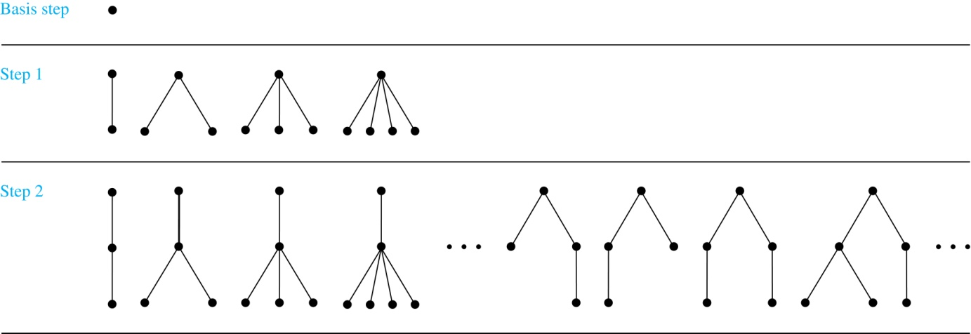
Building Up Rooted Trees

Slide 109
Full Binary Trees
Definition: The set of full binary trees can be defined recursively by these steps.
BASIS STEP: There is a full binary tree consisting of only a single vertex r.
RECURSIVE STEP: If T₁ and T₂ are disjoint full binary trees, there is a full binary tree, denoted by T₁∙T₂, consisting of a root r together with edges connecting the root to each of the roots of the left subtree T₁ and the right subtree T₂.

Slide 110
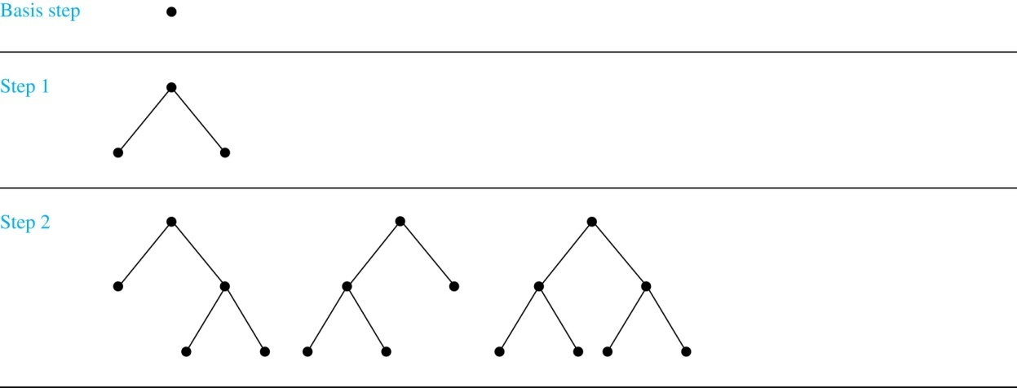
Building Up Full Binary Trees

Slide 111
Induction and Recursively Defined Sets
Example: Show that the set S defined by specifying that 3 ∊ S and that if x ∊ S and y ∊ S, then x + y is in S, is the set of all positive integers that are multiples of 3.
Solution: Let A be the set of all positive integers divisible by 3. To prove that A = S, show that A is a subset of S and S is a subset of A.
A⊂ S: Let P(n) be the statement that 3n belongs to S.
BASIS STEP: 3∙1 = 3 ∊ S, by the first part of recursive definition.
INDUCTIVE STEP: Assume P(k) is true. By the second part of the recursive definition, if 3k ∊ S, then since 3 ∊ S, 3k + 3 = 3(k + 1) ∊ S. Hence, P(k + 1) is true.
S ⊂ A:
BASIS STEP: 3 ∊ S by the first part of recursive definition, and 3 = 3∙1.
INDUCTIVE STEP: The second part of the recursive definition adds x +y to S, if both x and y are in S. If x and y are both in A, then both x and y are divisible by 3. By part (i) of Theorem 1 of Section 4.1, it follows that x + y is divisible by 3.
We used mathematical induction to prove a result about a recursively defined set. Next we study a more direct form induction for proving results about recursively defined sets.

Slide 112
Structural Induction
Definition: To prove a property of the elements of a recursively defined set, we use structural induction.
BASIS STEP: Show that the result holds for all elements specified in the basis step of the recursive definition.
RECURSIVE STEP: Show that if the statement is true for each of the (old) elements used to construct new elements in the recursive step of the definition, the result holds for these new elements.
The validity of structural induction can be shown to follow from the principle of mathematical induction.

Slide 113
Full Binary Trees
Definition: The height h(T) of a full binary tree T is defined recursively as follows:
BASIS STEP: The height of a full binary tree T consisting of only a root r is h(T) = 0.
RECURSIVE STEP: If T₁ and T₂ are full binary trees, then the full binary tree T = T₁∙T₂ has height h(T) = 1 + max(h(T₁),h(T₂)).
The number of vertices n(T) of a full binary tree T satisfies the following recursive formula:
BASIS STEP: The number of vertices of a full binary tree T consisting of only a root r is n(T) = 1.
RECURSIVE STEP: If T₁ and T₂ are full binary trees, then the full binary tree T = T₁∙T₂ has the number of vertices n(T) = 1 + n(T₁) + n(T₂).

Slide 114
Structural Induction and Binary Trees
Theorem: If T is a full binary tree, then n(T) ≤ 2^{h(T)+1} – 1.
⁻² .

Slide 115
Structural Induction and Binary Trees
Theorem: If T is a full binary tree, then n(T) ≤ 2^{h(T)+1} – 1.
Proof: Use structural induction.
BASIS STEP: The result holds for a full binary tree consisting only of a root, n(T) = 1 and h(T) = 0. Hence, n(T) = 1 ≤ 2⁰⁺¹ – 1 = 1.
RECURSIVE STEP: Assume n(T₁) ≤ 2^{h(T1)+1} – 1 and also n(T₂) ≤ 2^{h(T2)+1} – 1 whenever T₁ and T₂ are full binary trees.
n(T) = 1 + n(T₁) + n(T₂) (by recursive formula of n(T))
≤ 1 + (2^{h(T1)+1} – 1) + (2^{h(T2)+1} – 1) (by inductive hypothesis)
≤ 2∙max(2^{h(T1)+1} ,2^{h(T2)+1} ) – 1
= 2∙2^{max(h(T1),h(T2))+1} – 1 (max(2^{x} , 2^{y})= 2^{max(x,y)} )
= 2∙2^{h(t)} – 1 (by recursive definition of h(T))
= 2^{h(t)+1} – 1
⁻² .

Slide 116
Section 6: Recursive Algorithms

Slide 117
Section Outline
Recursive Algorithms
Proving Recursive Algorithms Correct

Slide 118
Recursive Algorithms
Definition: An algorithm is called recursive if it solves a problem by reducing it to an instance of the same problem with smaller input.
For the algorithm to terminate, the instance of the problem must eventually be reduced to some initial case for which the solution is known.

Slide 119
Recursive Factorial Algorithm
Example: Give a recursive algorithm for computing n!, where n is a nonnegative integer.
Solution: Use the recursive definition of the factorial function.
procedure factorial(n: nonnegative integer)
if n = 0 then return 1
else return n∙ factorial (n − 1)
{output is n!}

Slide 120
Recursive Exponentiation Algorithm
Example: Give a recursive algorithm for computing a^{n}, where a is a nonzero real number and n is a nonnegative integer.
Solution: Use the recursive definition of a^{n}.
procedure power(a: nonzero real number, n: nonnegative integer)
if n = 0 then return 1
else return a∙ power (a, n − 1)
{output is a^{n}}

Slide 121
Recursive GCD Algorithm
Example: Give a recursive algorithm for computing the greatest common divisor of two nonnegative integers a and b with a < b.
Solution: Use the reduction
gcd(a,b) = gcd(b mod a, a)
and the condition gcd(0,b) = b when b > 0.
procedure gcd(a,b: nonnegative integers with a < b)
if a = 0 then return b
else return gcd (b mod a, a)
{output is gcd(a, b)}

Slide 122
Proving Recursive Algorithms Correct
Both mathematical induction and strong induction are useful techniques to show that recursive algorithms always produce the correct output.
Example: Prove that the algorithm for computing the powers of real numbers is correct.
procedure power(a: nonzero real number, n: nonnegative integer)
if n = 0 then return 1
else return a∙ power (a, n − 1)
{output is a^{n}}
Solution: Use mathematical induction on the exponent n.
BASIS STEP: a⁰ =1 for every nonzero real number a, and power(a,0) = 1.
INDUCTIVE STEP: The inductive hypothesis is that power(a,k) = a^{k}, for all a ≠0. Assuming the inductive hypothesis, the algorithm correctly computes a^{k+1}, since
power(a,k + 1) = a∙ power (a, k) = a∙ a^{k} = a^{k+1} .
⁻² .

Slide 123
Summary
A proof establishes the truth of a statement using a (logically) valid argument
Proofs are needed in many practical aspects of CSE: To verify a program is correct, to establish programs are secure, to show the system specifications are consistent, to enable AI programs to make valid inferences, etc.
Theorem, Lemma, Corollary and Propositions are terms used for statements which can be proven to be true

Slide 124
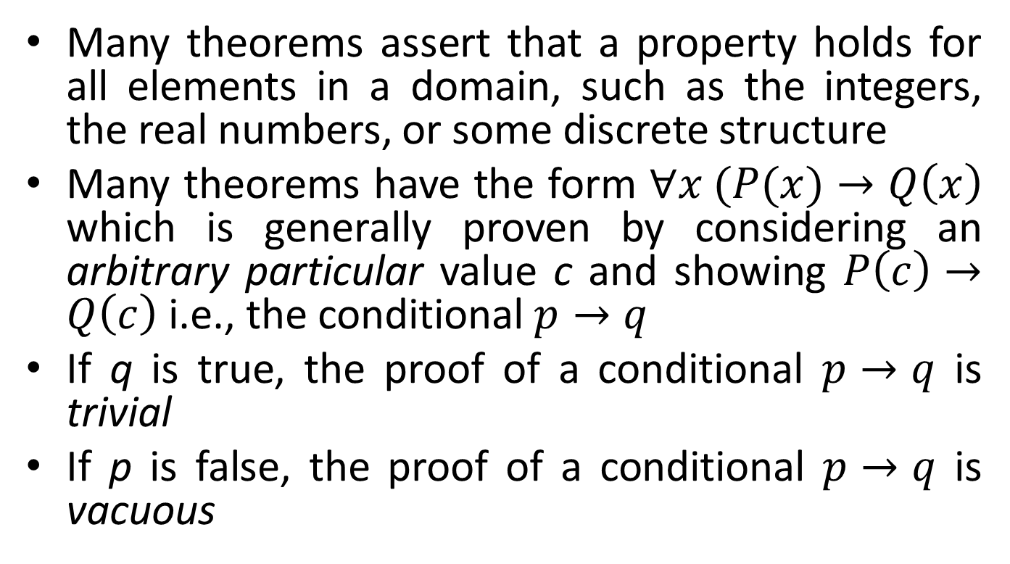
Summary
Many theorems assert that a property holds for all elements in a domain, such as the integers, the real numbers, or some discrete structure
Many theorems have the form $∀x (P(x)→Q\left(x\right)$ which is generally proven by considering an arbitrary particular value c and showing $P\left(c\right)→Q\left(c\right)$ i.e., the conditional $p→q$
If q is true, the proof of a conditional $p→q$ is trivial
If p is false, the proof of a conditional $p→q$ is vacuous

Slide 125
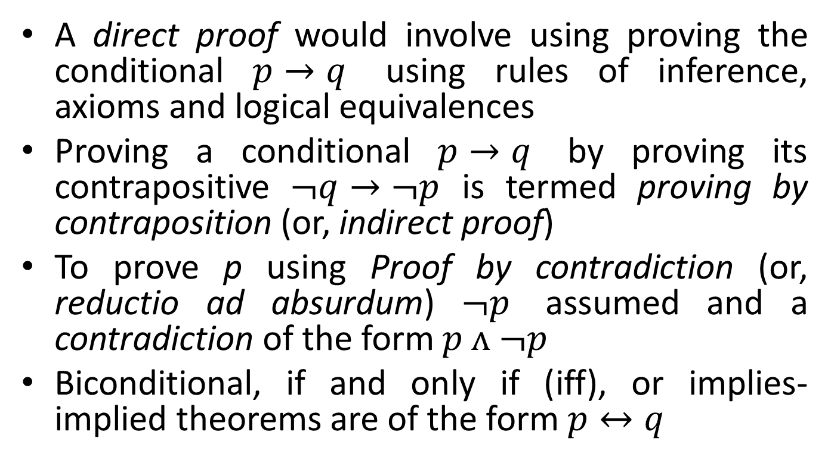
Summary
A direct proof would involve using proving the conditional $p→q$ using rules of inference, axioms and logical equivalences
Proving a conditional $p→q$ by proving its contrapositive $¬q→¬p$ is termed proving by contraposition (or, indirect proof)
To prove p using Proof by contradiction (or, reductio ad absurdum) $¬p$ assumed and a contradiction of the form $p ᴧ ¬p$
Biconditional, if and only if (iff), or implies-implied theorems are of the form $p↔q$

Slide 126
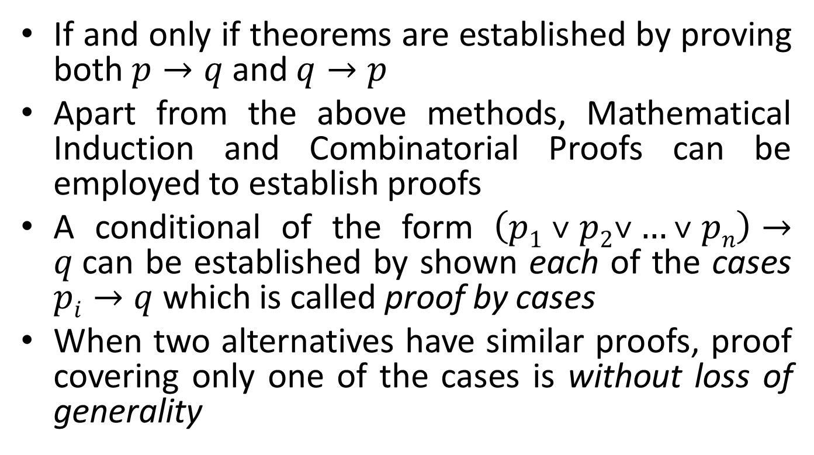
Summary
If and only if theorems are established by proving both $p→q$ and $q→p$
Apart from the above methods, Mathematical Induction and Combinatorial Proofs can be employed to establish proofs
A conditional of the form $\left(p1 ˅ p2˅…˅ pn\right)→q$can be established by shown each of the cases $pi→q$ which is called proof by cases
When two alternatives have similar proofs, proof covering only one of the cases is without loss of generality

Slide 127
Summary
Existence Proofs establish that a statement is satisfied by at least one value
Existence Proofs can be constructive or non-constructive
Constructive proof is by finding an explicit value for which the proposition is true
Disproof is proof that a statement is invalid
Counterexample is constructive way of disproving a statement

Slide 128
Summary
Uniqueness Theorems asset the existence of a unique element with a particular property: ∃!x P(x)
The two parts of a uniqueness proof are Existence, which shows that an element x with the property exists, and Uniqueness which shows that if y≠x, then y does not have the property
Open Problems are unsolved problems
Mathematical Induction and its variants are a set of powerful proof techniques

Slide 129
Summary
Principle of Mathematical Induction states that to prove that P(n) is true for all positive integers n, two steps need to be completed: 1) Basis Step: Show that P(b) is true for some integer b and 2) Inductive Step: Show that P(k) → P(k + 1) is true for all positive integers k
The inductive step of Mathematical Induction is completed by assuming the inductive hypothesis that P(k) holds for an arbitrary integer k and showing that must P(k + 1) be true
Mathematical induction is valid because of the well ordering property, which states that “Every nonempty subset of the set of positive integers has a least element.’’

Slide 130
Summary
Conjecturing a formula for general term in a sequence and proving it using Mathematical Induction is a common application of the later
Principle of Strong Induction states that to prove that P(n) is true for all positive integers n, where P(n) is a propositional function, complete two steps: 1) Basis Step: Verify that the proposition P(1) is true and 2) Inductive Step: Show the conditional statement [P(1) ∧ P(2) ∧∙∙∙ ∧ P(k)] → P(k + 1) holds for all positive integers k
Strong Induction is sometimes called the second principle of mathematical induction or complete induction

Slide 131
Summary
Well-ordering property: Every nonempty set of nonnegative integers has a least element
Principles of Mathematical Induction, Strong Induction and Well Ordering Property are equivalent: Hence any one can be chosen to prove a statement
The choice of induction form for proving a statement depends on the later: sometimes it is clear how to proceed with one the alternatives

Slide 132
Summary
Sequences, data structures such as trees and algorithms can be defined recursively
Structural induction can be employed to establish statements about recursively defined structures

